Slide 1
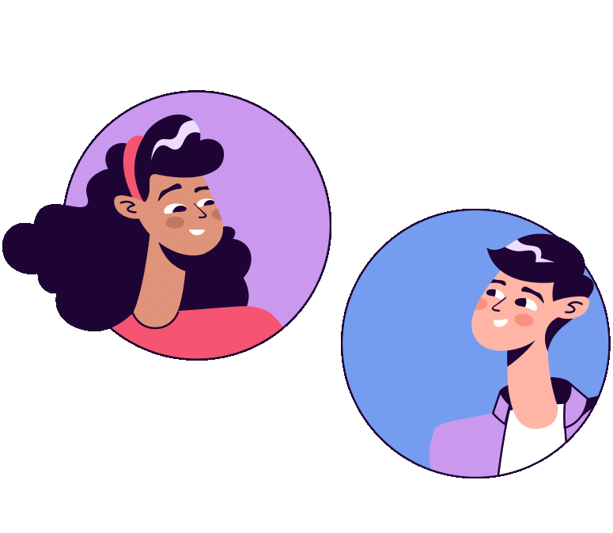
Language Use

Slide 2
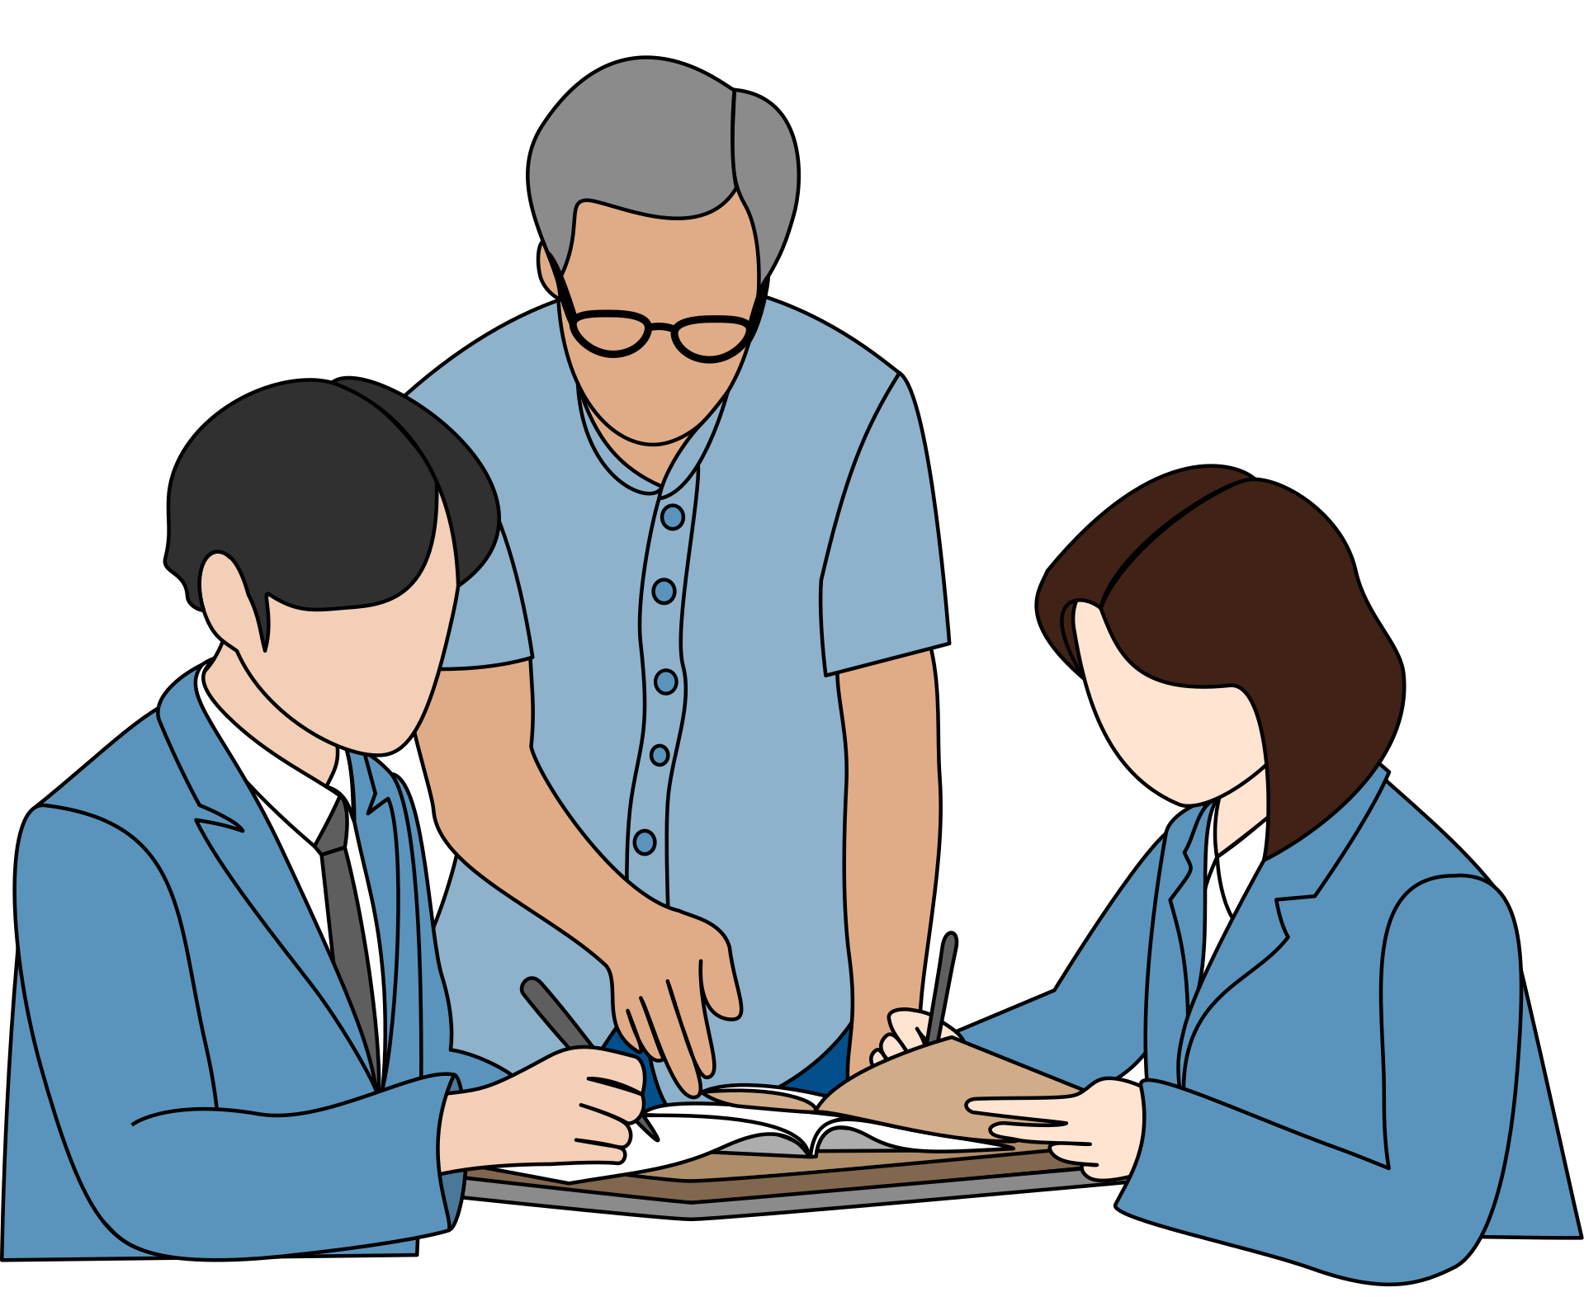


Formal Language
Informal Language

Slide 3


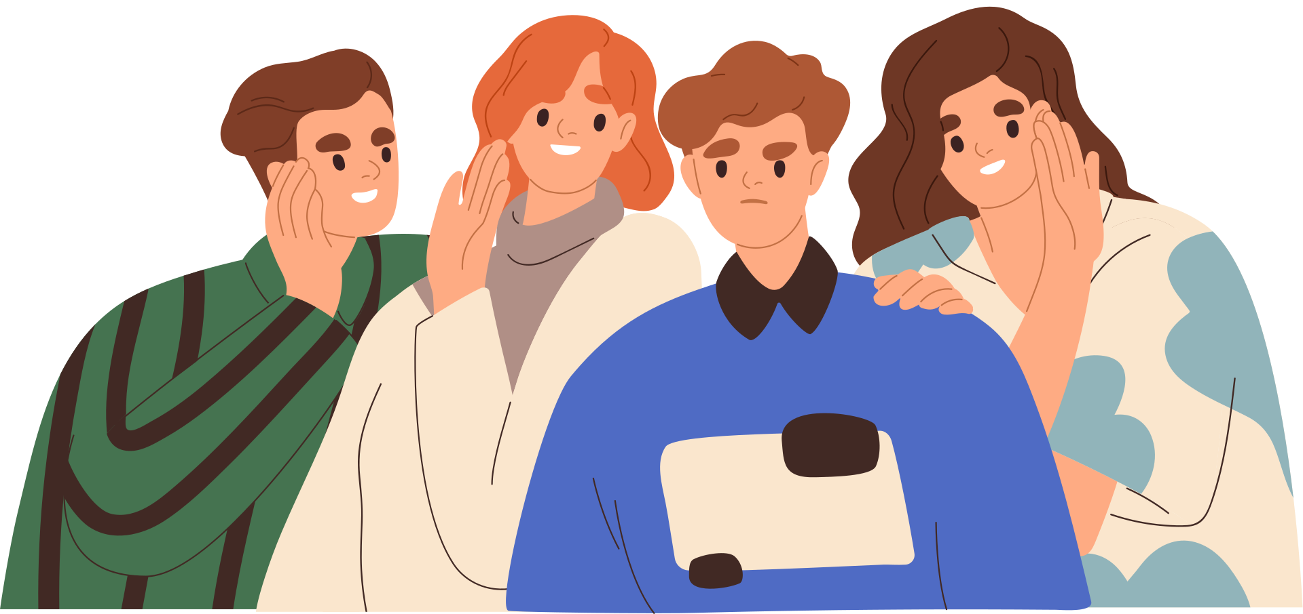
Try it!
Give me some words or phrases that you usually say to your friends or classmates.
Notes:
3

Slide 4
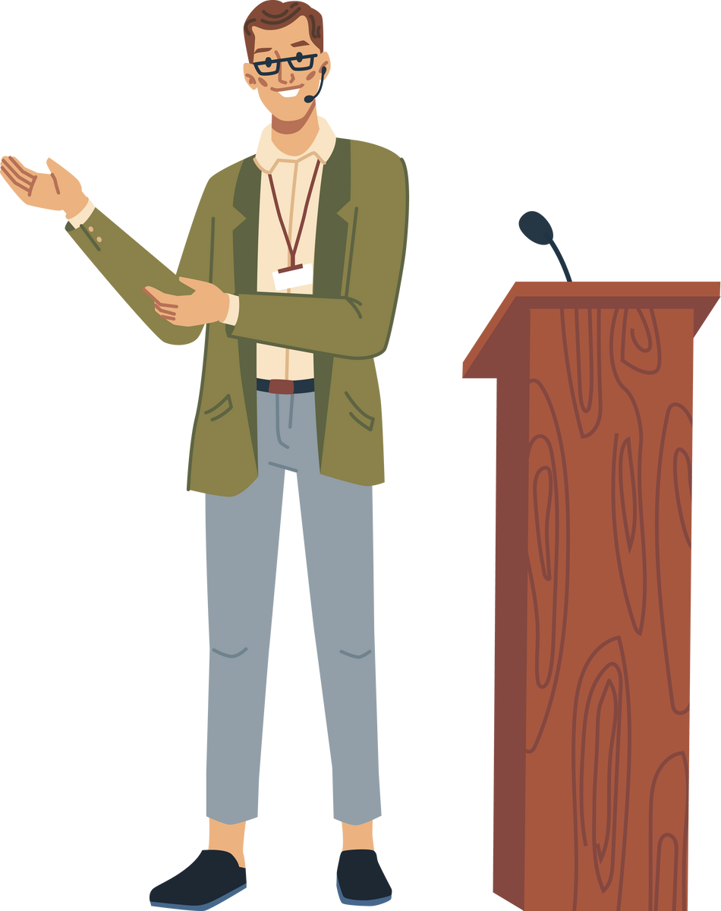
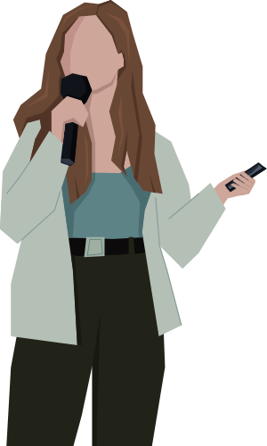
How do we speak during formal occasions?
How do we speak during informal gatherings?
Notes:
6

Slide 5
Informal Language
It is used in personal texts meant for family, friends, and colleagues. When you send e-mails or write messages to friends and family members close to your age, this is usually the type of language you use.
Notes:
7

Slide 6
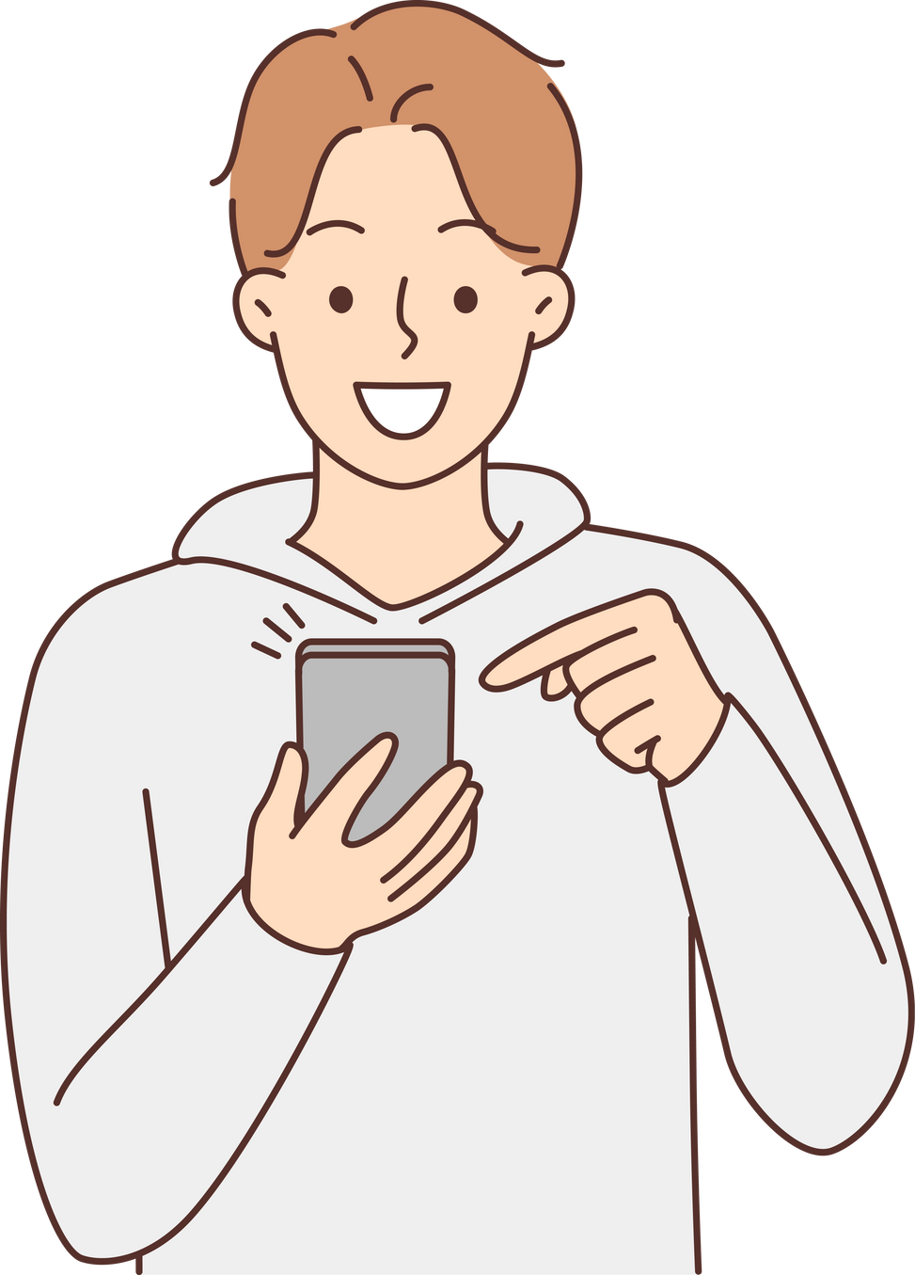
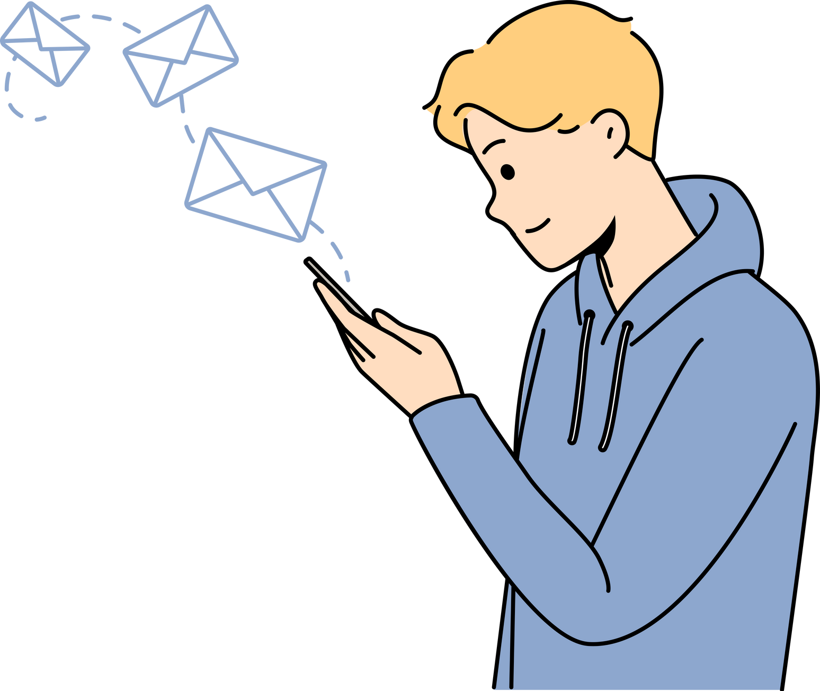
Erwin 2:03 PM
Hey, feel like hanging out later?
Gerald 2:10 PM
Not feeling well atm. Maybe tomorrow.
Notes:
7

Slide 7
Formal Language
It is used in academic, business, and official texts. This is the language you use when writing formal correspondence and memorandums, both at school and work.
Notes:
8

Slide 8

I am writing to inform you that our kitchen area will be under construction as we remodel. From August 23 to August 28, please use the makeshift kitchen on the second floor.
If you have questions or concerns regarding the remodeling, you can access the full report here. We truly apologize for the inconvenience.
Notes:
8

Slide 9
Grammar | Informal | Formal
Use of Contractions | The project won’t push through until next month. | The project will not push through until next month.
Use of Phrasal Verbs | Mr. Smith, the patient in room 1305, got over his illness. | Mr. Smith, the patient in room 1305, recovered from his illness.
Use of Slang/ Colloquialism | The mob was very rowdy during the protest against mandatory drug tests among students. | The crowd was very rowdy during the protest against mandatory drug tests among students.
Use of Point of View | We considered various data collection methods for this research. | Various data collection methods were considered for this research.
Notes:
Contractions are avoided and replaced in formal language. Simplified and contracted words should only be present during casual communication processes.
Phrasal verbs are used in informal communication situations but are avoided in formal events.
Formal language is free of colloquialisms, slang, figures of speech, clichés, and improper and broken syntax, which are highly evident in informal language.
Formal language uses the third-person nouns and pronouns rather than the first-person or second-person nouns and pronouns.
9

Slide 10
Grammar | Informal | Formal
Sentence Structure | The president invites you and your family to the ball this August 31, 2019. | The president of the company would like to extend his invitation to the family members of the company for the ball this coming August 31, 2019.
Use of the Active or Passive Voice | He published his poetry collection last month. | His poetry collection was published last month.
Punctuation | OMG! I got the job. | Fortunately, I was able to get the job.
Notes:
Formal language often necessitates the use of longer and more complex sentences and phrases with details and descriptions about the main ideas of the writing passage.
Formal language uses the passive voice, which creates an impersonal tone. The impersonal tone is maintained in formal language to demonstrate that the writer or speaker has no personal connection to the readers or receivers of the message.
10

Slide 11
ATTENTION To all the members of The Showstoppers Club, Meet us at our hideout at 9-ish on Wednesday, Aug. 28. Bring fresh vibes and lots of love. Snacks are most welcome, too. By Sir Eddie & the club officers | ATTENTION To all the members of The Showstoppers Club, Please be reminded of the meeting (re: December event) on August 28, Wednesday, at 9:00 a.m. Also, we request members to bring snacks for sharing for the meeting may take a while. Thank you. Sir Eddie and the club officers
Notes:
Notice that the first announcement poster used informal language, while the second poster used formal language. This just shows the level of significance of the announcement and the relationship between the members and the officers.
11

Slide 12
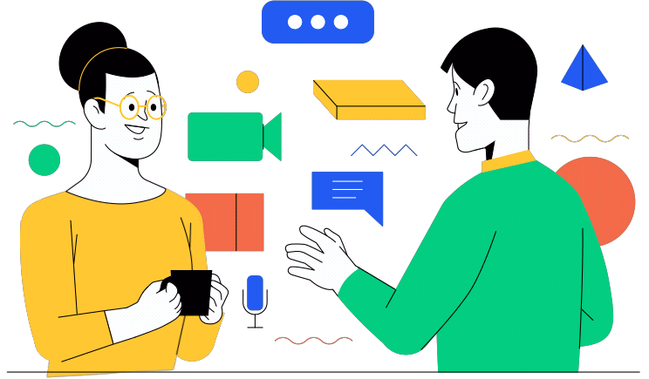
Familiar, Direct, and Simple Language

Slide 13
Familiar Language
It makes use of words commonly found in everyday life. It is also often called informal language, as both can be heard or read on a regular basis.
Notes:
For example, “Good morning!” is something you might hear every day, as opposed to “Top of the morning to you!” which means the same thing but is far less likely to be heard today.
Similarly, in the second set of sentences, “I would like to know how the incident happened” is considered familiar language, while “I would like to comprehend how the incident transpired” is a lot less likely to be heard in everyday conversations.
13

Slide 14
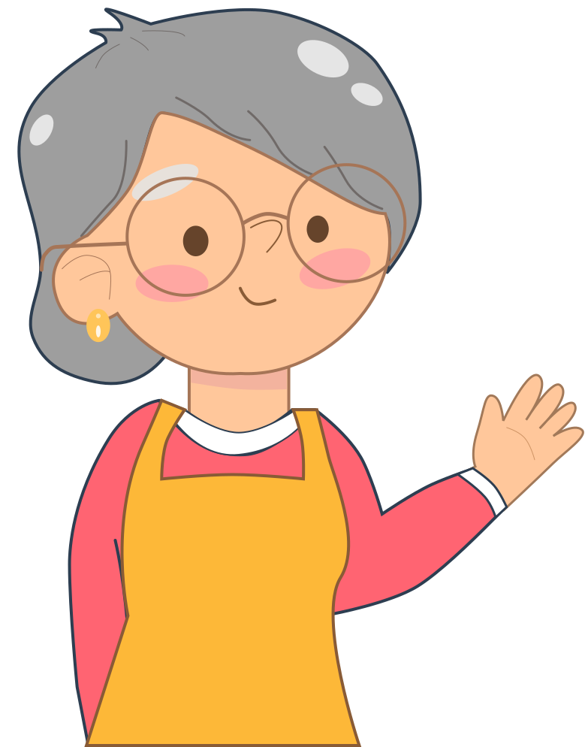
Gran, good morning!
Top of the morning to you!
Notes:
For example, “Good morning!” is something you might hear every day, as opposed to “Top of the morning to you!” which means the same thing but is far less likely to be heard today.
Similarly, in the second set of sentences, “I would like to know how the incident happened” is considered familiar language, while “I would like to comprehend how the incident transpired” is a lot less likely to be heard in everyday conversations.
13

Slide 15
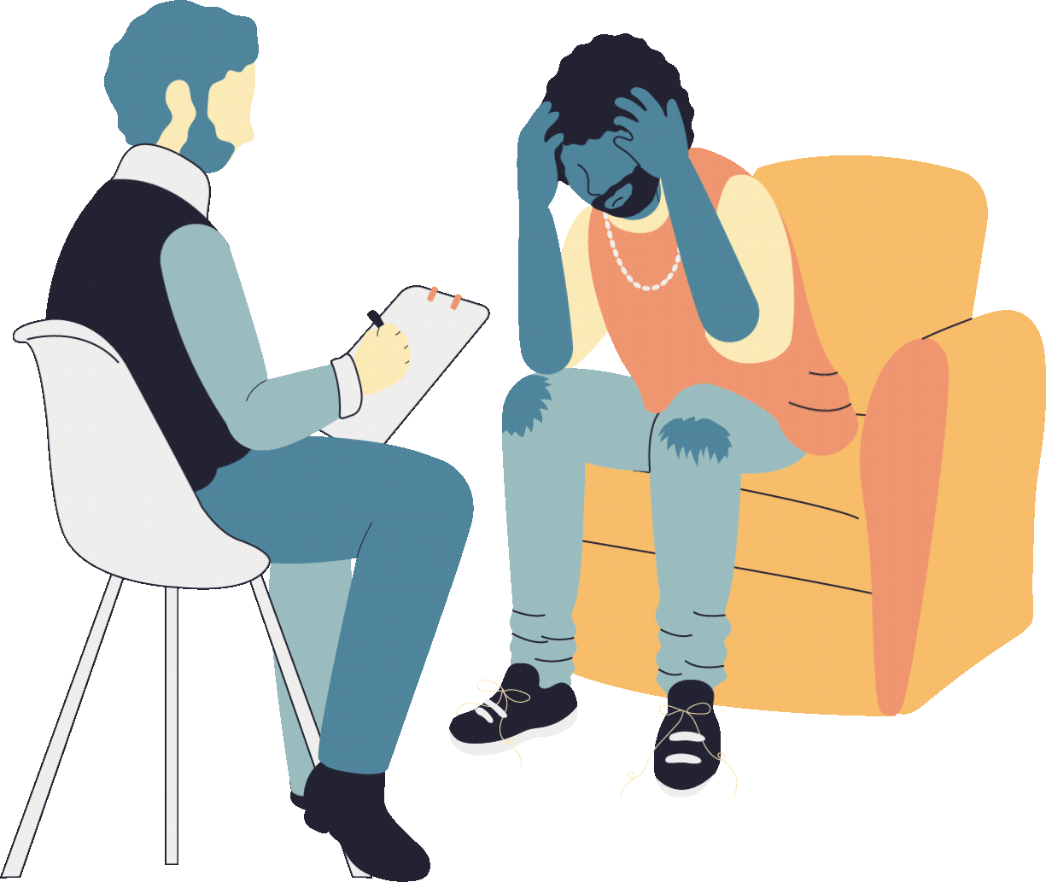
I would like to know how the incident happened.
I would like to comprehend how the incident transpired.
Notes:
For example, “Good morning!” is something you might hear every day, as opposed to “Top of the morning to you!” which means the same thing but is far less likely to be heard today.
Similarly, in the second set of sentences, “I would like to know how the incident happened” is considered familiar language, while “I would like to comprehend how the incident transpired” is a lot less likely to be heard in everyday conversations.
13

Slide 16
Direct Language
It makes use of words that are straight to the point.
Notes:
14

Slide 17
I don’t want to watch that movie.
I’m not sure I’d really appreciate that movie.
The plot is dull and boring. It would be best to change it.
The story has many admirable qualities. But you might want to consider improving the plot.
Notes:
14

Slide 18
Simple Language
It is similar to familiar language, as it makes use of words that are commonplace and easy to understand.
Notes:
15

Slide 19
I like her; she’s very friendly.
I am quite taken with her; she has an amiable disposition.
The speech was bad. The audience hated it.
The speech was in such execrable taste that it revolted the audience.
Notes:
14

Slide 20
Study the following sentences. Notice the differences in the language used.
She gave a lot of excuses for her mistakes.
The secretary offered a plethora of excuses for her shortcomings.
Please give me a pair of those shoes in size 7.
I want those shoes in my size.
Notes:
In this set of examples, it is recognizable that the level of formality varies. The first statement used familiar and simple vocabulary while the second statement used complex vocabulary.
16

Slide 21
Familiar Language vs. Obscure Language
Familiar language is that which the readers easily recognize and understand because they use it on a regular basis. It is our responsibility to create a sense of commonality between the person we are communicating with. By using language that is familiar to others, the message is likely to have more impact.
Notes:
17

Slide 22
Direct Language vs. Indirect Language
Direct language is used when you want to express something clearly, concisely, and candidly. Indirect language often sacrifices clarity, but at times, it makes the language more colorful, polite, or intentionally difficult to understand.
Notes:
18

Slide 23
Simple Language vs. Complex Language
Simple language is obviously easier to understand, whereas complex language is difficult. At times, complex language is used to demonstrate or reflect formality, superiority, and academic achievements.
Notes:
19

Slide 24

Biased and Unbiased Language

Slide 25
Unbiased Language or Biased-Free Language
A responsible communicator has to be sensitive enough to avoid offensive remarks toward an individual or a particular group of people.
The message must be free of any stereotype toward ethnicity, religion, political interest, social class, and the like. Of equal importance, one must avoid using slurs or pejorative language.
Notes:
21

Slide 26
Age | Race and Ethnicity | Disability
Refer to a person’s age only when it is relevant to the message. If you use a generic age description, ask your subjects what wording they prefer. In communications meant to represent a range of experiences or viewpoints, include people of diverse ages. | Be sure your words do not patronize or give token attention to members of racial or ethnic groups. Stay attuned to the current terminology by which racial and ethnic groups refer to themselves. Be sensitive to religion as well when referring to various ethnic groups. | The terms impairment, disability, and handicap are not synonymous. Be sensitive in using each. Put people first, not their disabilities. Avoid language that portrays people with disabilities as either unfortunate helpless victims or—at the other extreme—as courageous superhumans.
Notes:
22

Slide 27
Tips to Ensure the Use of Unbiased Language
Use names or labels that individuals or groups choose for themselves.
Have you seen the new student? I heard he’s a Mohammedan.
Notes:
It is no longer considered acceptable to use the term Mohammedan, as it is now considered offensive. Instead, the politically term Muslim should be used.
23

Slide 28
Do not mention group membership unnecessarily.
The senior citizen complained to the cashier about the defective item she bought a day ago.
Notes:
It is unnecessary to mention that the person is a senior citizen, as this suggests age bias.
24

Slide 29
Be aware of words that certain groups of people find negative or offensive and avoid using them.
It’s too bad that Carol got into an accident and became a cripple.
Notes:
The term cripple is offensive. It would be better to use the term disabled person instead.
25

Slide 30

Gender-Neutral Language

Slide 31
Gender-Neutral Language
A communicator should be careful not to favor a certain gender when constructing sentences.
The term “gender-neutral language” is a generic term covering the use of non-sexist language, inclusive language or gender-fair language.
Notes:
27

Slide 32
Gender-Neutral Language
Its purpose is to avoid words that may be interpreted as biased, discriminatory, or demeaning by implying that one sex or social gender is the norm.
Using gender-fair and inclusive language also helps reduce gender stereotyping, promotes social change, and contributes to achieving gender equality.
Notes:
27

Slide 33
Notice the difference between the given statements.
The researcher must submit his proposal before the deadline.
The researcher must submit his or her proposal before the deadline.
Notes:
In the first sentence, the pronoun his is used even though a researcher could also be female. This shows bias against women. The second sentence, on the other hand, used both a masculine and a feminine pronoun, which eliminates gender bias from the sentence.
28

Slide 34
Please all rise in welcoming this year’s faculty and their wives.
Please all rise in welcoming this year’s faculty and their spouses.
This company needs a more passionate and dedicated manpower.
This company needs a more passionate and dedicated workforce.
Notes:
In the first set, the first sentence assumes that all the faculty members are men. The use of the word spouses in the second sentence, on the other hand, is inclusive and free from gender bias.
Remember to include all people in general references by substituting gender-neutral words and phrases for gender-biased words. For example, the word manpower can be replaced by the terms workforce or human resources.
29

Slide 35
The use of masculine or feminine pronouns may create gender bias, which is evident in the following statement:
Each employee must submit his photo for filing.
This can be avoided by doing the following:
Drop the pronoun that signifies gender and restructure the statement.
Each employee must submit a photo for filing.
Notes:
30

Slide 36
2. Change to plural construction.
Employees must submit their photos for filing.
3. Replace the masculine or feminine pronoun with one or you.
You must submit your photo for filing.
Notes:
31

